Slide 1
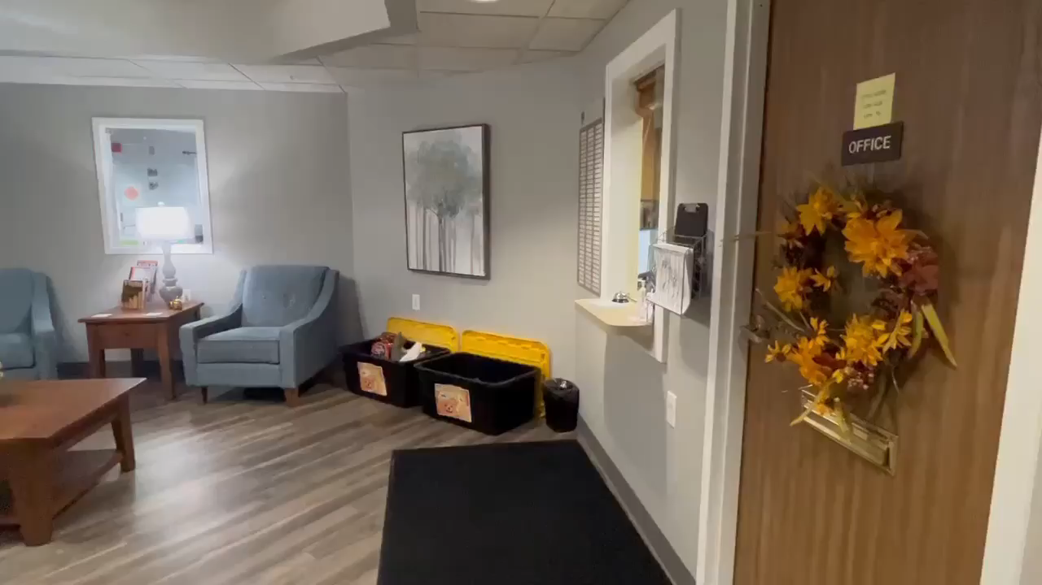
Welcome to Christian Care!
Press play on each clip to see our wonderful facility.

Slide 2
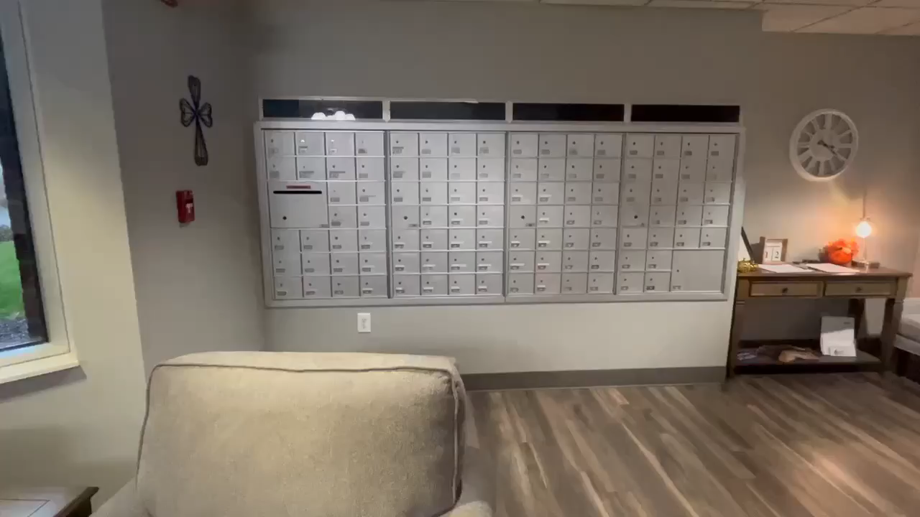
Lobby and Mail Room
Located in our lobby are:
Business Office- Residents and/or their families may make deposits and/or withdrawals from Resident Trust Funds, pay bills, or ask questions regarding resident finances.
Resident Mailboxes- Residents receive their mail in their personal, locked mailboxes and may send mail out in the community mail box.
Sign-out Sheets- Family or friends who take residents out of the building for appointments or social reasons must sign the residents out on these sheets. Your help in keeping track of our residents’ where-abouts is very important to their safety and care.

Slide 3
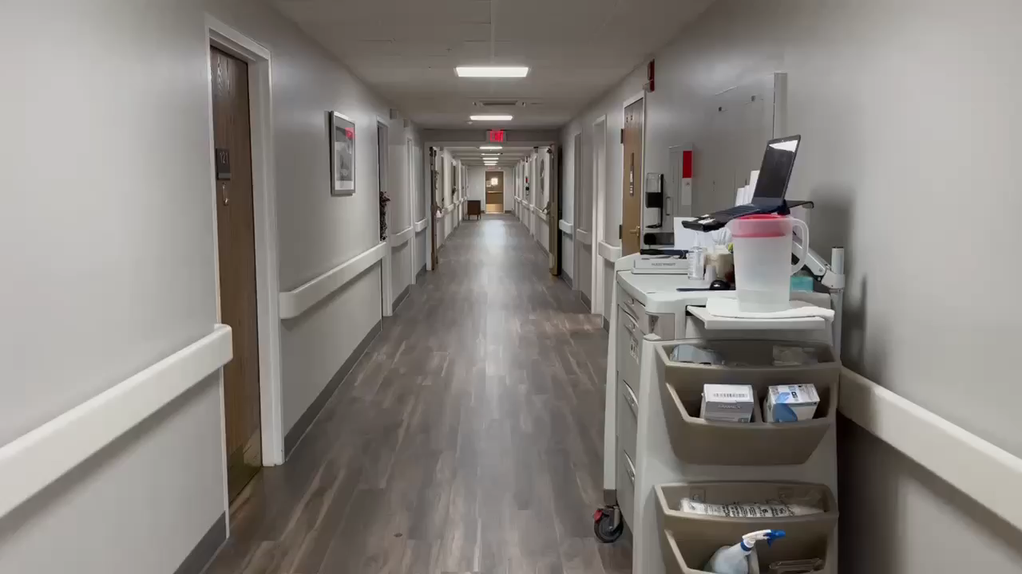
First Floor
Located on the first and second floor are:
Resident apartments
Resident Care Stations
A kitchenette
A resident Lounge
Staff Offices are also located on the first floor.

Slide 4
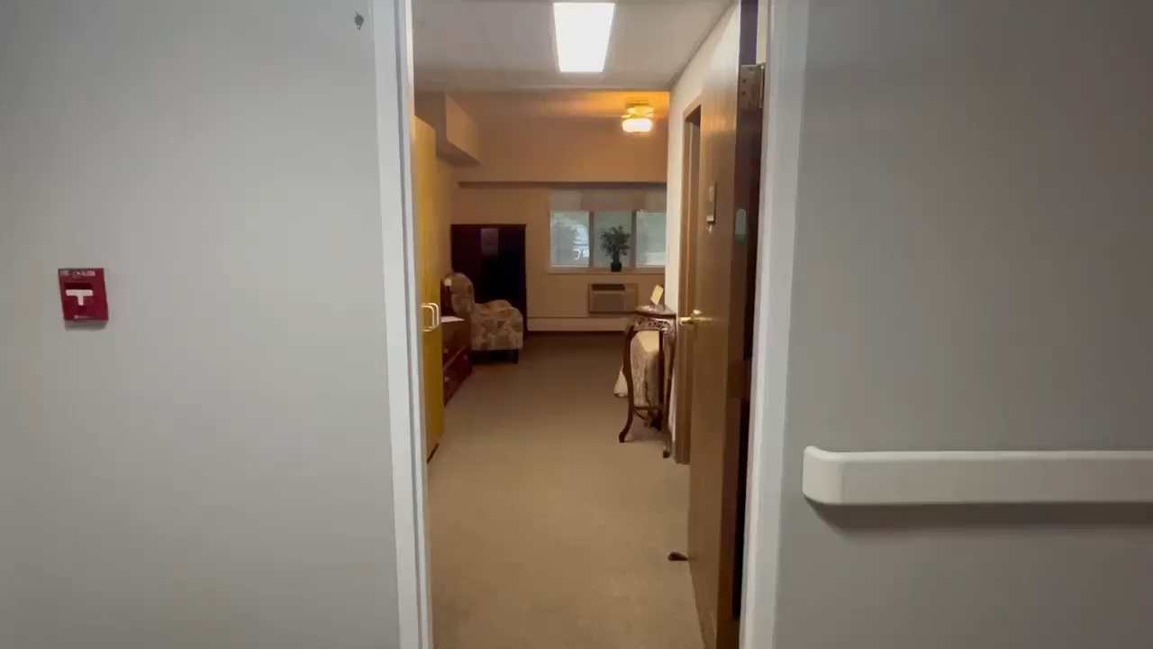
Resident Room
Rooms are studio style and private. All rooms are air-conditioned. Bathrooms may be private or shared by one other resident. Christian Care furnishes single beds, chest of drawers, and nightstands, but residents are encouraged to make the apartments homier by using their own furnishings and decorations.

Slide 5
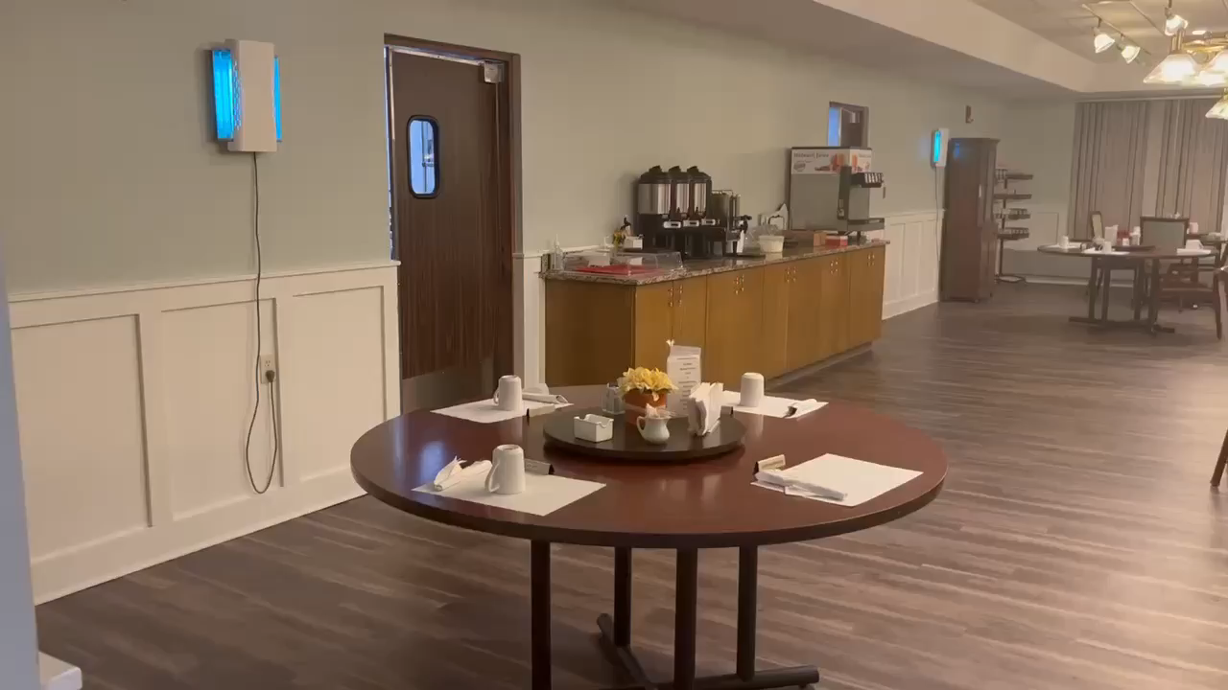
Dining Room
Residents may eat Breakfast, Lunch, and Dinner here, in our lovely dining room.
Residents may dine in their rooms, but socialization is encouraged and a lot more fun.
Large Activities such as parties and Bingo are held in here also.

Slide 6
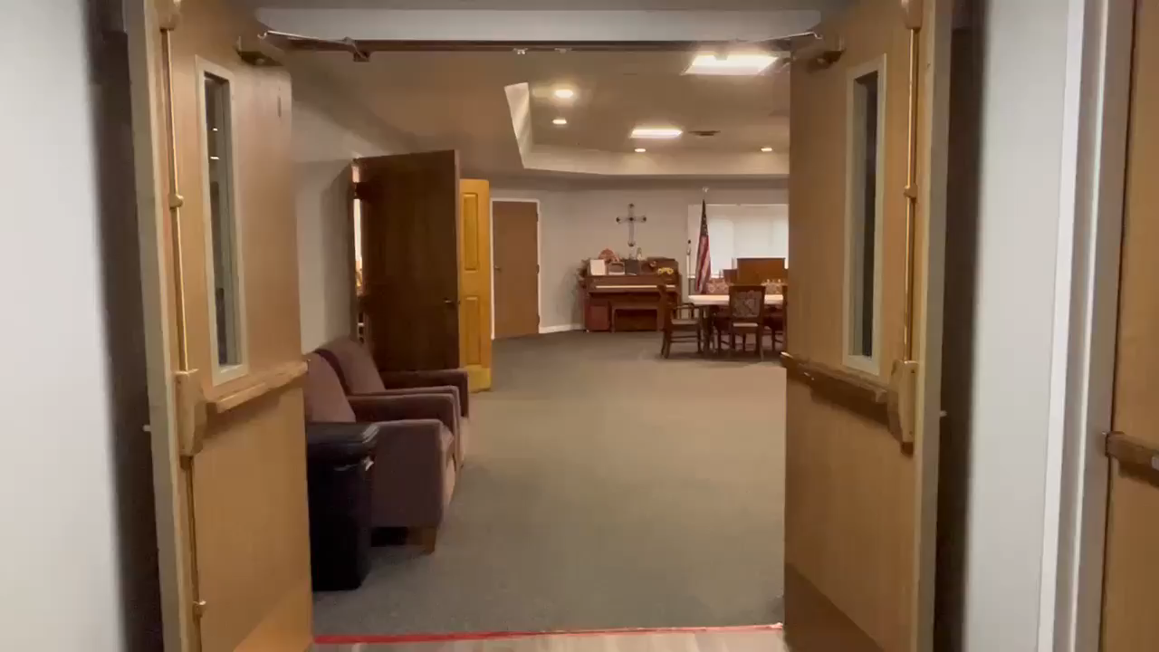
The Chapel
The Chapel is home to group activities at Christian Care.
Residents may enjoy church services, Bible Study, Games, Bowling, Manicures, Live Musical Performances, Exercise, Movies, and much more!
This is where the fun starts!

